Slide 1

Writing your first website with GitHub pages
By Itera and Vitalii Ruban

Slide 2
About me
Name: Vitaliy Ruban
Works with Itera: 4 years
Writing in: JavaScript and C#

Slide 3
We will learn about
Source Control System and Git
Markup, CSS, JavaScript
Deploying site to the real world with GitHubPages
Notes:
Topics are huge, we will not cover all of them

Slide 4
Prerequisites
Create an account at https://github.com
Install git from https://git-scm.com/downloads
Install VsCode from https://code.visualstudio.com/
Install Node.JS (LTS) https://nodejs.org/en/
Web Server for Chrome https://chrome.google.com/webstore/detail/web-server-for-chrome/ofhbbkphhbklhfoeikjpcbhemlocgigb

Slide 5
Drawing an owl

Slide 6

How to create a site

Slide 7
GIT and system version of control
SVC is very important tool in any development, regardless back or front-end
Main goal – save your progress and track changes with possibility to revert any change you did
Branching option – the second benefit from SVC, it allows you to work on the same file with your teammate at one time in one repo
Most popular are Git and SVN systems
Most important commands are clone, pull, commit, push, merge, branch and others
Works mostly with text formats

Slide 8
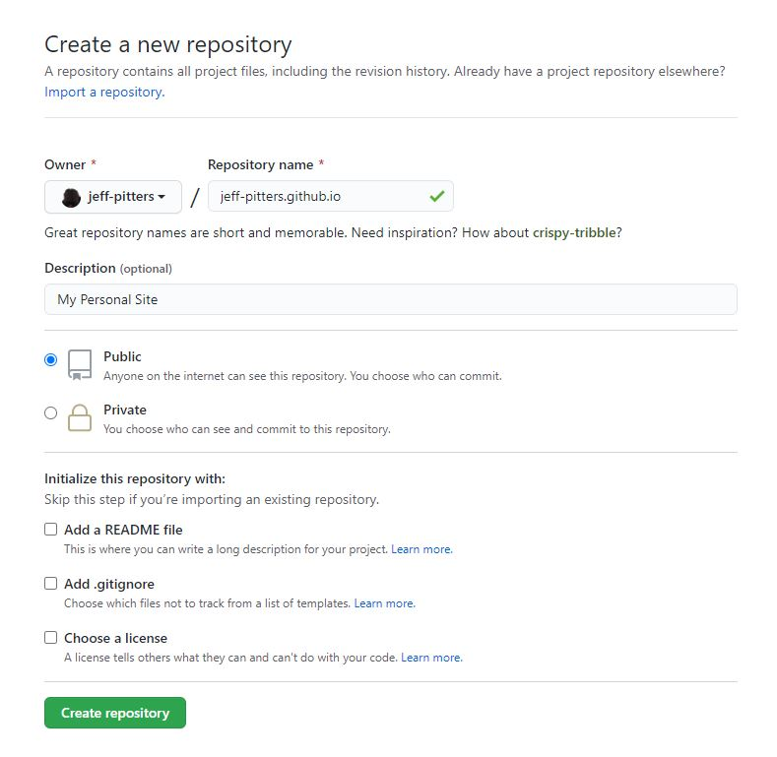
Create new repository: <username>.github.io
Notes:
еуые

Slide 9
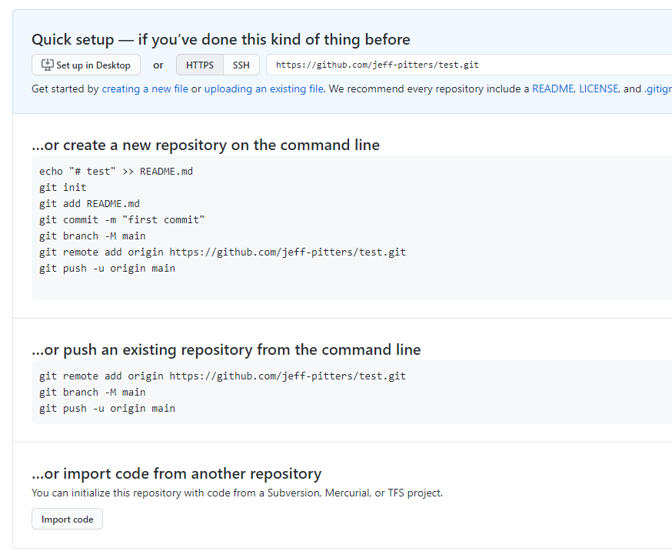
Clone repo locally
Open console
Check git with git
Execute command: git clone https://github.com/<username>/<username>.github.io.git

Slide 10
Create index.html
Move to the folder created on the previous step
Create index.html manually and add some text inside
Or use command echo "hello world" > index.html

Slide 11
Make it live
Push code to the remote repo using git push
Give it a minute
Check your URL - <username>.github.io

Slide 12
Note
Site is alive
It is publicly available for everybody, even for your Mam
Will be indexed by search engines in a next few weeks, so you can find it in Google

Slide 13
Let’s make it real

Slide 14
Not okey
Almost no content
No styles
No interaction

Slide 15
Content - Markup
Hypertext Markup Language (HTML) is the standard markup language for documents designed to be displayed in a web browser.
Used to display content of the page.
Contains about 110 elements (called tags). Not all of them actively used.
Uses 4+1 type of layouts – inline, inline-block, block, flex and grid

Slide 16
Semantic markup
Semantic markup is important
Semantic markup is simple*
Use <button> for buttons, use <link> for the links, use <img> for the image. Do you get the point?
*There are some tough things, but, at least, try to follow easy cases.

Slide 17
<!DOCTYPE html>
<html lang="en">
<head>
<meta charset="UTF-8" />
<meta name="viewport" content="width=device-width, initial-scale=1.0" />
<title>My Personal Site</title>
</head>
<body>
<p>hello world</p>
</body>
</html>
HTML declaration
Language
Meta information block
Visible are of the page
Encoding
Page title
Content block
Paragraph with classical text

Slide 18
shortcut
If you are using VsCode, you can type Html:5+tab shortcut to get basic HTML template
Use Chrome -> F12 -> Developer Console to discover and modify your markup on the fly.

Slide 19
Adding first image
Create new folder: img
Put there any image named me.png
Add new tag to the body: <img src="./img/me.png" alt= “my photo" />
Open index.html with browser and observe the fail

Slide 20
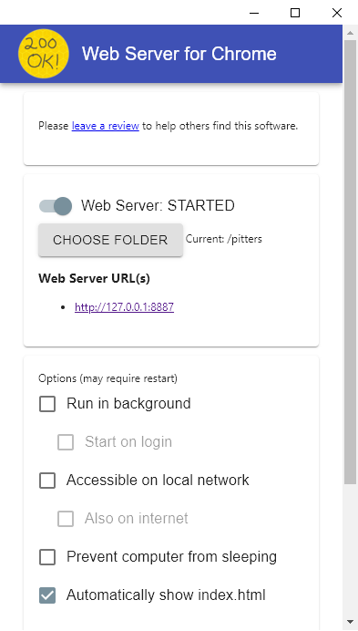
Running site locally
Install web-server-for-chrome extension
Select your folder
Open provided link

Slide 21
Styles - CSS
Cascading Style Sheets (CSS) is a style sheet language used for describing the presentation of a document written in a markup language such as HTML.
Uses selectors to apply styles to the element
Uses cascading inheritance to apply the same styles to the child element, so you can DRY
Contains an incredible number of properties
Can do incredibly beautiful things!

Slide 23
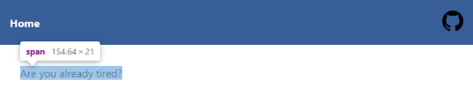
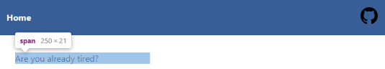
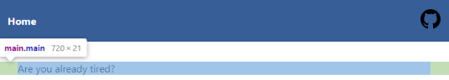
Layouts
Inline – used mostly for pure text and images. Element will occupy space exactly for content
Inline-block – will be sized as previous, but you can assign width and height manually
Block - element will occupy all available width – div, main, footer, etc.
Each element has its own layout by default that can be overridden

Slide 24
Selectors
tag selector – apply styles for all given tags on the page
.my-class selector, apply styles for the elements with class = my-class.
#my-id selector, apply styles for the element with id =my-id. Not that id should be unique per page
Selectors apply sequentially from top to the bottom
Selectors have weight and may conquer with each other

Slide 25
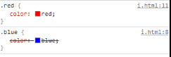
Selectors apply sequentially
<style>
.red { color: red; }
.blue { color: blue; }
</style>
<span class="blue red">What color?</span>

Slide 26
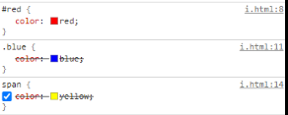
Selectors have weight
<style>
#red { color: red; }
.blue { color: blue; }
span { color: yellow; }
</style>
<span class="blue" id="red"> What color?</span>

Slide 27
Stop theory – let’s style
Create new folder named styles
Put index.css file inside the new folder
Connect it to the index.html placing <link href="./styles/index.css" rel="stylesheet"> into the head section

Slide 28
Stop theory – let’s style
Update index.html with next code:
Update index.css with next code:
<main class="main">
<img src="./img/me.png" alt="just me">
</main>
.main {
display: flex;
align-items: center;
justify-content: center;
height: 100vh;
}

Slide 29
Interactions - JAvascript
JavaScript often abbreviated as JS, is a programming language that conforms to the ECMAScript specification. JavaScript is high-level, often just-in-time compiled, and multi-paradigm. It has curly-bracket syntax, dynamic typing, prototype-based object-orientation, and first-class functions.
Runs in browser and servers. Most known runtime for JS is V8 from Google
Created by Brendan Eich in 1995
JavaScript !== Java

Slide 30
const a = 1;
const b = "2";
const ab = a + b; ??
('b'+'a' + + 'a'+'a').toLowerCase(); ??
// "banana"
// "12"
0.1 + 0.2 === 0.3 ??
// false
1 == "1"; ??
1 === "1"; ??
const user = {
name: "test",
printName: function () {
return this.name;
},
};
console.log(user.printName()); ??
function printer(getName) {
const name = getName();
console.log(name);
}
printer(user.printName); ??
// true
// false
// test
// undefined

Slide 31

I will never say anything bad regarding JavaScript
Because it is listening

Slide 32
Let’s add some interaction
Create new folder script
Put index.js file inside the new folder
Link it to the page using <script src="./script/index.js"></script>

Slide 33
Let’s add some interaction
Update index.html with next code
Update index.js with next code
<main class="main">
<img src="./img/me.png" alt="just me">
<div>I am just a dev <button id="like">&hearts;</button></div>
</main>
(function () {
const $like = document.querySelector("#like");
$like.addEventListener("click", () => ($like.style.color = "red"));
})();

Slide 34
Final result
<!DOCTYPE html>
<html lang="en">
<head>
<meta charset="UTF-8">
<meta name="viewport" content="width=device-width, initial-scale=1.0">
<title>My Personal Site</title>
<link href="./styles/index.css" rel="stylesheet">
</head>
<body>
<main class="main">
<img src="./img/me.png" alt="just me">
<div class="bio">I am just a dev <button id="like">&hearts;</button></div>
</main>
<script src="./js/index.js"></script>
</body>
</html>

Slide 35
TOP question on the Stackoverflow
Can’t read <property> of undefined when I am working with a DOM node
I am trying to applying styles to the element through JavaScript, but nothing happening

Slide 36
IMPORTANT!
document.addEventListener('DOMContentLoaded', (event) => {
console.log('DOM fully loaded and parsed');
});

Slide 37
Publish time
Open you site locally and check the result
Use git push to publish final version

Slide 38
Like the google does

Slide 39
What was wrong
Not possible* to reference files from other modules
For some old browsers, code may not work at all because we used modern JavaScript syntax – arrow functions and const keyword
Code and styles are not minimized, the page will load slower
No modern tooling support like TypeScript, css-preprocessors, image optimization, etc.
Pushing to the server all files from the root folder, including sensitive data
* We will not discuss modules and HTTP 2.0 right now.

Slide 40
How to fix
Apply better structure
Use bundler
Use gh-pages to publish

Slide 41
Structure
Initialize project file using npm init -y command
Create new folder named src
Move index.html there
Move css, img, and js folder inside the src folder
This is common way for the project organizing

Slide 42
Node package manager
NPM – registry to distribute your JavaScript code among other people. It contains most popular libraries, frameworks and tools based on JavaScript
NPM – is command line tool that helps you interact with NPM and other more less related staff
Anybody can contribute to the NPM. It’s free.

Slide 43
Setup parcel
Parcel – modern tool for processing and bundling web assets
Use npm install parcel –D command
Update package.json with
"scripts": {
"parcel": "parcel",
"start": "npm run parcel src/index.html",
"build": "npm run parcel build src/index.html"
},

Slide 44
Setup GITHUB pages
Install github-pages with npm install gh-pages -D
Create publish.js files in the root with next content
Update package json with new release script
const gh = require("gh-pages");
gh.publish("dist", () => console.log("done"));
"release": "node publish"

Slide 45
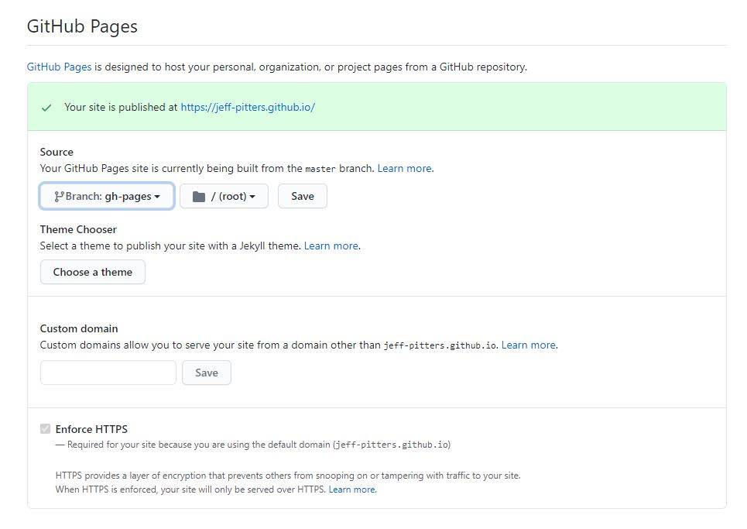
Update the source
Go to the project settings and update source of the site from master to gh-pages

Slide 46
Release like a big guys do*
To test that everything working properly run
npm run build
npm run release
Observe results
*Ask me why is the asterisk here and listen about CI/CD/CD pipeline. This is how it really works

Slide 47
save your work
Update .gitignore file and exclude
node_modules
dist
.cache
Commit and push your code

Slide 48
Benefits
We can use modern frameworks without pain - React, PReact or Vue frameworks
We can use TypeScript almost without configuration
We can use CSS preprocessors like scss and less almost without configuration
Hot module reloading

Slide 49
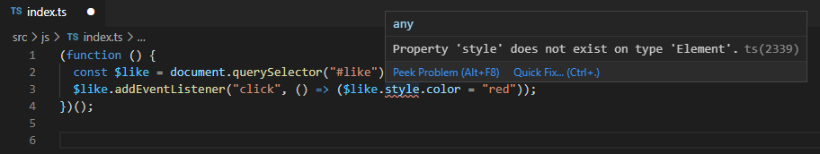
Example
Rename index.js file into index.ts file
Change src in the index.html
Observe the result:

Slide 50
Correct version
(function () {
const $like = document.querySelector("#like");
if ($like instanceof HTMLElement) {
$like.addEventListener("click", () => ($like.style.color = "red"));
}
})();

Slide 51
Static website vs Single page application
Static website – for content
Static website – content exists while loading
Usually written with some static site generators or templates
Might not require JavaScript at all
SPA – content will be created after scripts being loaded
SPA – for actions
Usually writing with Angular, React or Vue frameworks
Not possible to use without JavaScript

Slide 52
Questions?

Slide 53
homework
Markup – Add the footer the site and some content. Try to use semantic markup
CSS – restyle like button to get rid of borders and other button-like stuff
JavaScript – add a code that will insert current year to the footer, but don’t hardcode the year, use new Date() instead

